Slide 1
The ‘Four Ps’
Dr Jenny Lloyd
Associate Professor in Marketing

Slide 2
Session objectives
By the end of this session you will :
Understand the concept of the ’marketing mix’
Have reflected upon three elements: product, place and promotion
Their role within the wider product concept
The relationship between each of the elements
Considered the relationship between these three elements

Slide 3
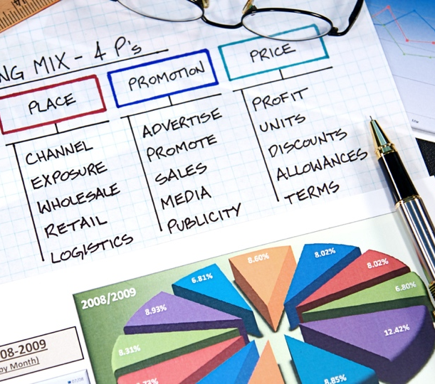
The Marketing Mix, or 4Ps (McCarthy 1964)
Product
Place (distribution)
Promotion
Price

Slide 4
’P’ No. 1: ‘Product’

Slide 5
What is a product?
‘Anything that is offered to a market for attention, acquisition, use or consumption, and includes physical objects, services, persons, places, organisations and ideas or mixes of these entities.’ (Kotler et al. 2008: 561)
... anything that is capable of satisfying customer needs.’ (Jobber and Ellis-Chadwick 2013: 308)
Can include organisations, persons, places and ideas, too (e.g. politicians, celebrities, destinations and social marketing campaigns)

Slide 6
The total product offer (anatomy) adapted from Kotler et al. (1999: 562)
?
Potential
Everything potentially
feasible to attract
and hold customers; the ‘ideal’
Augmented
Value-added features
and benefits to the
target customer group
Installation
Customer support
Selection
?
Packaging
Brand name
Styling/ design
After-sales service
Core
Basic problem-solving
benefits; utility of the
product or service (i.e. what’s it for?)
Delivery
Features
Actual
Physical good or delivered service that provides expected benefit(s) (features, packaging, etc)
Quality
Warranty
?
Credit
?
Core Product
30% of impact, but
70% of total costs
Product ‘Surround’
70% of impact, but
only 30% of total costs

Slide 7
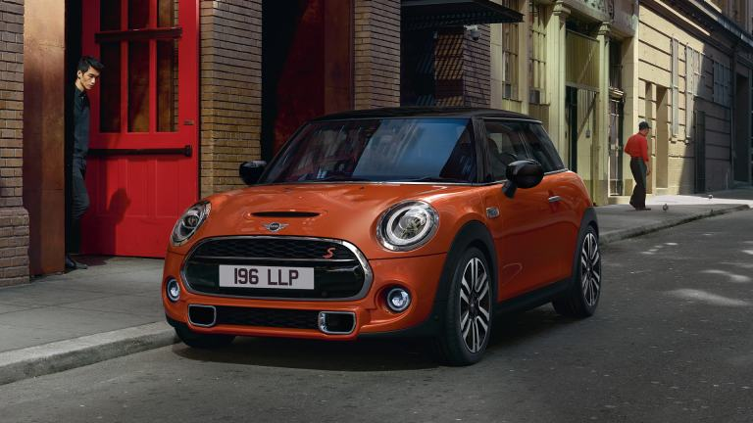
The total product offer (anatomy) adapted from Kotler et al. (1999: 562)
Core: Transport from A to B
Actual: Car bodywork, technology, engine, technology
Augmented: After sales service, Mini Owners Club
Potential: Classic car value, kudos attached to having a cute car
?
?

Slide 8
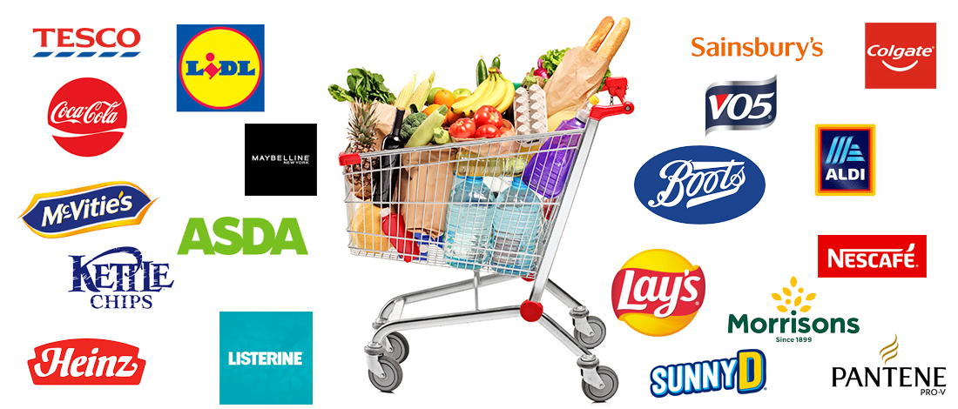


Types of products
FMCG – Fast moving consumer goods
Services
Consumer durables

Slide 9
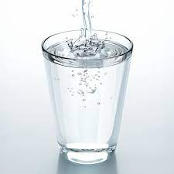
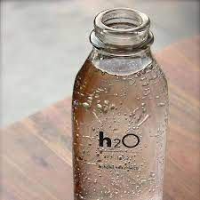
What is the difference between a ’product’ and a ‘brand’?
‘A product is something with a functional purpose. A brand offers something in addition to its functional purpose. All brands are products… but not all products are brands.’ (Jones 1986, p. 29)

Slide 10




What is a brand?
A name, term, symbol, design or a combination of these, which is used to identify the goods or services of one seller or group of sellers and to differentiate them from those of competitors. (Kotler et al 2001)
A brand is a set of associations linked to a name, mark or symbol associated with a product or service. The difference between a name and a brand is a name that doesn’t have associations; it is simply a name. A name becomes a brand when people link it to other things. (Calkins 2005)
Powerful brands communicate their values through every point of contact they have with consumers (White & de Chernatony, 2002)

Slide 11
Product decisions (Kotler et al 2009)
Determine the total ‘product offer’ ...
... product quality and features, style and design, branding, packaging and labelling, support services
Identify not only the functional benefits delivered by the product, but also the emotional and psychological benefits delivered by the brand.
Think about the stage of the product in its life-cycle (introduction, growth, maturity and decline)
different mix tactics are appropriate at different stages
Product decisions are inseparable from other mix decisions
Impact upon pricing, promotion and place…and what about the ‘service’ elemnents?

Slide 12
’P’ No. 2: ‘Place’

Slide 13
'Place’: where, when, in the right form and in the right quantities…
Reconciles needs of producers and consumers
Improves efficiency
Improves accessibility
Provides specialist services
How the product gets from supplier to the customer/consumer.
Often referred to as the ‘channel of distribution’, ‘route to market’ or ‘supply chain’.
Takes into account the needs of the ultimate consumer but also the channel intermediaries.
(Jobber and Ellis-Chadwick 2013)

Slide 14
Distribution channels
Producer
Consumer
Producer
Retailer/
Intermediary
Consumer
Producer
Wholesaler
Retailer/
Intermediary
Consumer
Producer
Agent
Wholesaler
Retailer/
Intermediary
Consumer
(Jobber and Ellis-Chadwick 2013)c

Slide 15
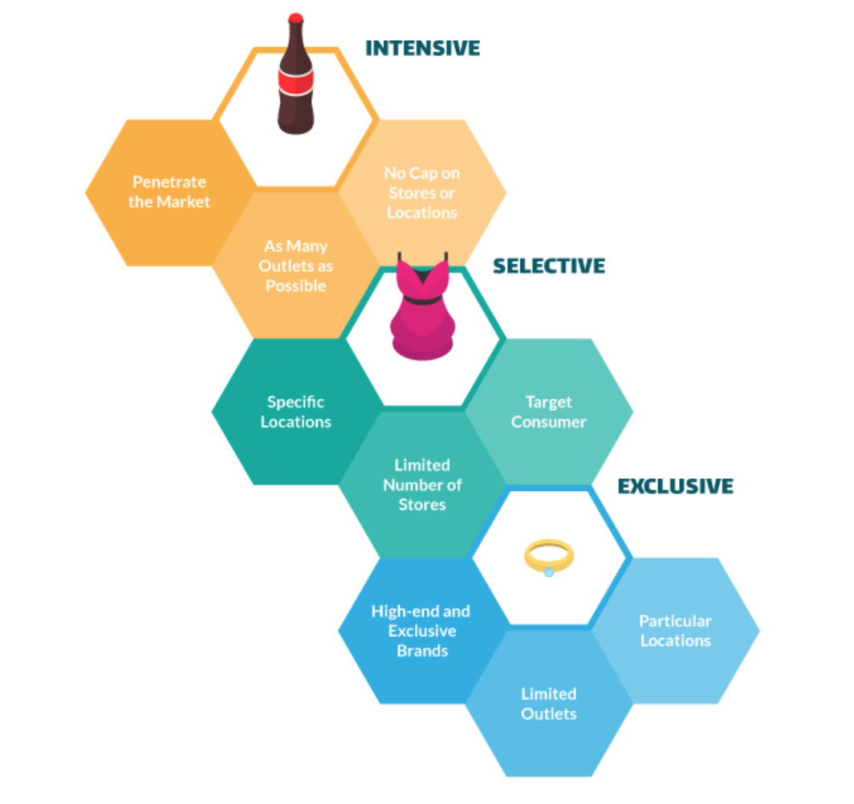
Types of distribution
Intensive
Selective
Exclusive
Distribution choices create powerful communication touchpoints
…and incur cost and pricing implications
(Jobber and Ellis-Chadwick 2013)

Slide 16
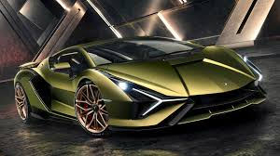
Why it’s important to get your choice of distributor right…

Slide 17
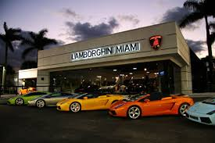
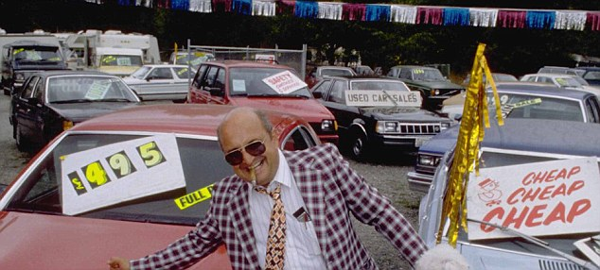
Consider…

Slide 18
Consider…

Slide 19
Consider…

Slide 20
‘P’ No. 3: ‘Promotion’

Slide 21

Promotion
Increasingly referred to as ‘integrated marketing communications’ or ‘omnichannel’ (i.e. no longer just about promoting and persuading)
A planned and integrated set of activities for communicating with each of an organisation’s stakeholder groups
The creation of a set of ‘touchpoints’ that will raise awareness, shape attitudes and change behaviour.

Slide 22
‘Is used to communicate elements of an organisation’s offering to its target audience’
Fill (2009)
‘Is a management process through which an organisation engages with its various target audiences’
Fill (2009)
Marketing communications is concerned with engagement: the planned, integrated and controlled dialogues with key target audiences to help achieve mutually beneficial objectives.
Dahlen, Lange and Smith (2010)
Defining marketing communications

Slide 23
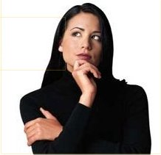
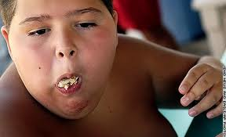
The challenge of communication strategy…
Planned Communication
Unplanned communication
Communication outcome
Paid
Earned
Owned

Slide 24
Marcoms can be used to achieve a number of cognitive and behavioural changes
Brand repositioning
Changing misunderstanding
Building credibility
Changing performance beliefs
Changing attribute priorities
Introducing a new attribute
Changing the perception of a competitor’s product
Changing/introducing new brand associations
Using corporate branding to extend credibility
Dahlen, Lange and Smith (2010)

Slide 25
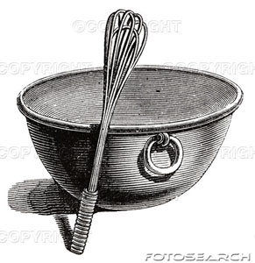
The ‘classic’ promotional mix
Advertising
Public relations
Personal selling
Direct marketing
Sales promotion

Slide 26
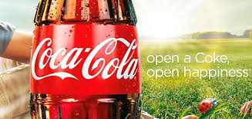
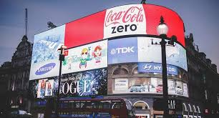
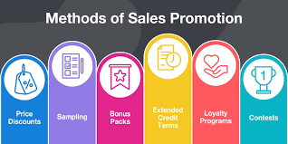
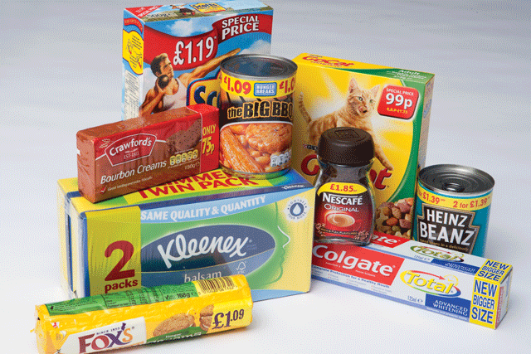
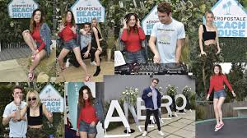
Promotional tools
Advertising – non-personal form of communication, where a sponsor pays for a message to be transferred through media; capable of reaching a large audience; aims to raise awareness and position product in consumers’ minds
Sales promotion – direct inducements or incentives to buy a product or service; concerned with offering additional value in return for a(n immediate) sale (e.g. sampling, coupons, deals)
Public relations (PR) – influences stakeholders’ perceptions of an organisation; doesn’t require the purchase of airtime or advertising space, therefore low-cost and perceived to be more credible (e.g. press releases, shows, networking, lobbying, etc)

Slide 27
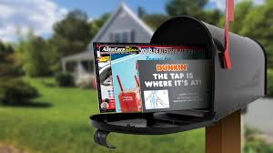

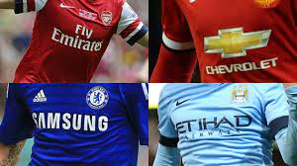
Promotional tools
Direct marketing – drives a response and shapes behaviour by sending personalised and customised messages; used to create and sustain personal, intermediary-free communication with (would-be) customers and significant stakeholders
Personal selling – interpersonal communication that provides information, develops positive feelings and stimulates required behaviour; undertaken by individuals or, collectively, a salesforce; very potent (if biased), but reach is limited
Sponsorship – ‘a commercial activity whereby one party permits another to exploit an association with a target audience in return for funds, services or resources’
Fill (2002)

Slide 28
The media Baines et al. (2011)
Broadcast – TV and radio
Print – newspapers, consumer magazines, trade press
Outdoor – billboards, street furniture, transit (e.g. on public transport)
Digital – websites, social media (e.g. YouTube, Facebook, Instagram, Tiktok Twitter, Mastodon), etc
In-store – point of purchase (bins, signs, displays), packaging
Other – cinema, exhibitions, product placement (e.g. in films), ‘ambient’ (e.g. on petrol pumps), ‘guerrilla’ (e.g. flyposting)

Slide 29
An omnichannel/ integrated marketing communications approach….
involves bringing together the tools, the media and ideas about how messages should be developed ...
... so that audiences perceive a single, consistent and unified message (even though individual messages will be encoded in different ways, emphasising different types of appeal and using different media)
More effective and efficient than using any one tool or medium in isolation
...to be developed in the Integrated Marketing Communications lecture later in the term

Slide 30
Summary
Whilst the ‘product’ is the basic element that is constructed to satisfy needs and wants of consumers, other elements of the marketing mix determine the extent to which consumers recognise the benefit of the product and gain access to it.
Every aspect of the marketing mix acts a ‘touchpoint’ that communicates product attributes.
Therefore it is important that the marketing mix is constructed carefully and coherently to appeal to the target market.
One of the most powerful is price which we will cover in the asynchronous session and develop next week in the seminar.

